Slide 1



COMPANY
STRATEGIES AIMED AT CONVERTING CASUAL RIDERS INTO ANNUAL MEMBERS

Slide 2


CONTENTS
Introduction
Data Understanding
Analysis
Conclusion & Recomendation

Slide 3


INTRODUCTION

Slide 4

STAKEHOLDER
Directure of Marketing
Division Of Marketing

Slide 5

BACKGROUND
Company :
Members generate more annual profit than casuals
By converting casual customers into members who are already familiar with Divy making Divy bikes as mobility tool will be the key to future growth

Slide 6
PROBLEM
How to differentiate between members and casual riders ?
What can encourage casual riders to want to become a member?
Which stations have the most rentals by casuals ?

Slide 7

GOALS
Our Mission
1.
Analyze which time period having the most casual riders in Q3
2.
Analyze how Divy Members and Casual Rides use bicycles to determine which stations have the most casual riders that have a hight chance of converting into members

Slide 8
DATA UNDERSTANDING

Slide 9



Data Context
This database is taken https://divvybikes.com/
This database contains data of casual/members who traveled in September-2023 to December-2023
Limitation of Problem
Data analyzed is only in quartile 3 (Q3)
Riders are anonymous : no user data is stored

Slide 10
ATRIBUTE
Column | Description
ride_id | Identification number of the trip from the starting station to the ending station in a certain time
started_at | Date and time the trip starts
ended_at | Date and time the trip ends
start_station_name | The name of the station where the journey begins
member_casual | Type of rider

Slide 11
ATRIBUTE
Column | Description
time_interval | Time interval when the rides start
start_day | Day when the rides start
month | Month when the rides start
Week | Week when the rides start

Slide 12
DATA ANALYSIS

Slide 13
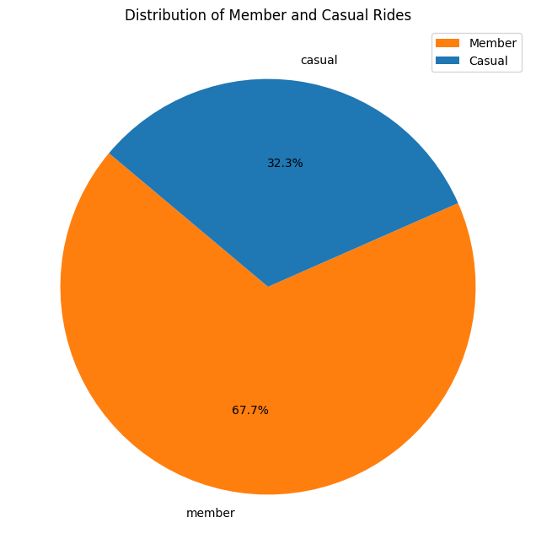
Distribution of
Casual & Member
It was found that the proportion of trips made by Casual users was less than the proportion of trips made by Member users

Slide 14
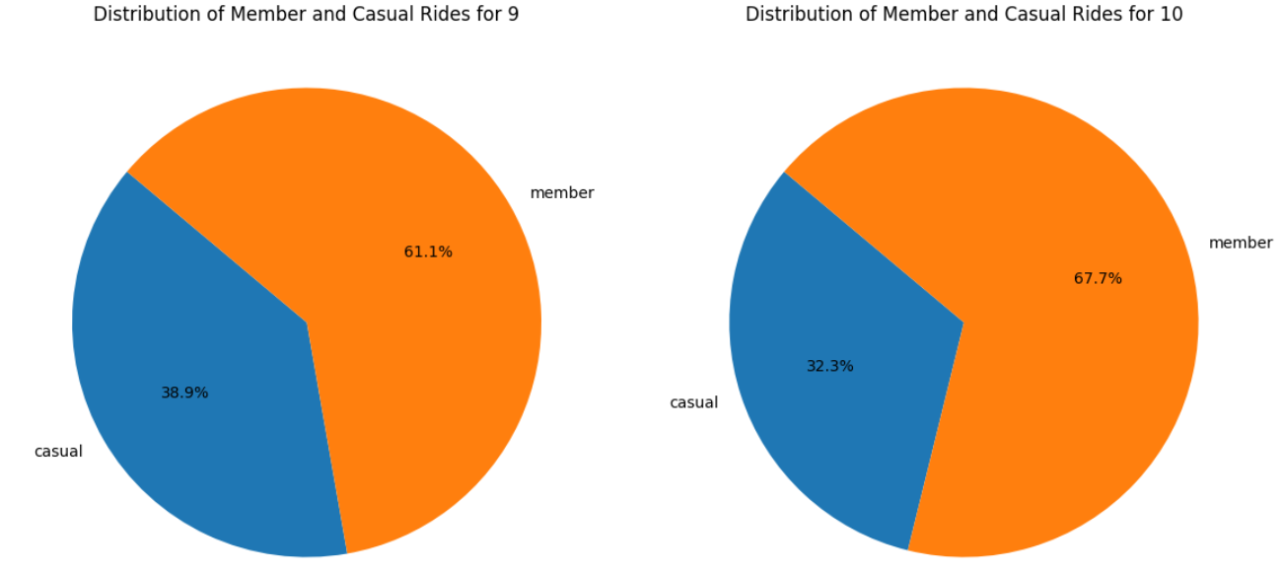
Distribution of Casual & Member Based on Month

Slide 15
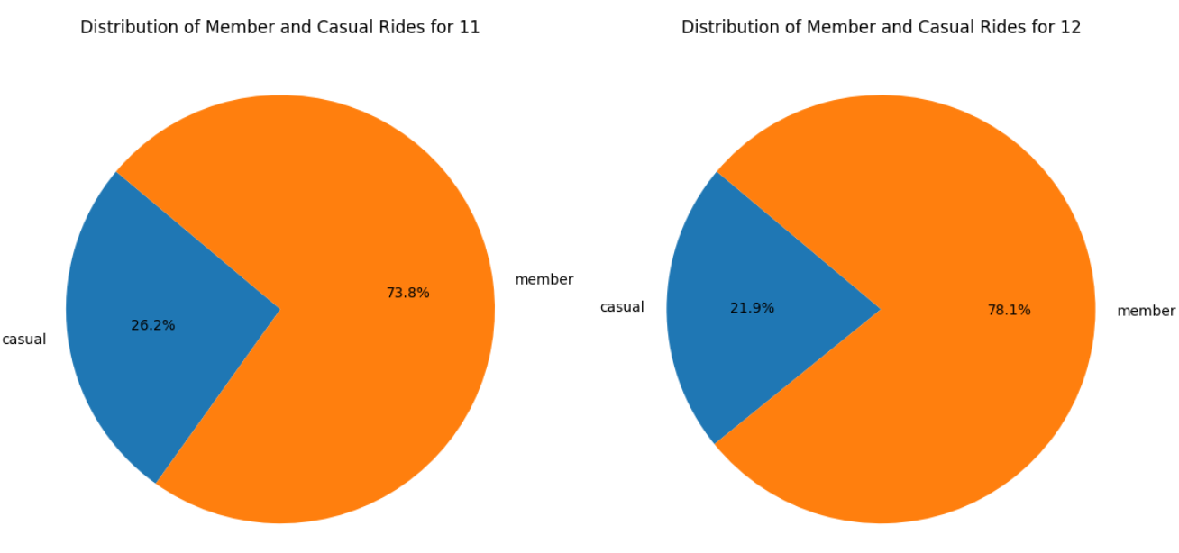
Distribution of Casual & Member Based on Month
From the graph above, it is found that the proportion of trips made by Casual users decreased from 38.9% in September to 22.0% in December

Slide 16

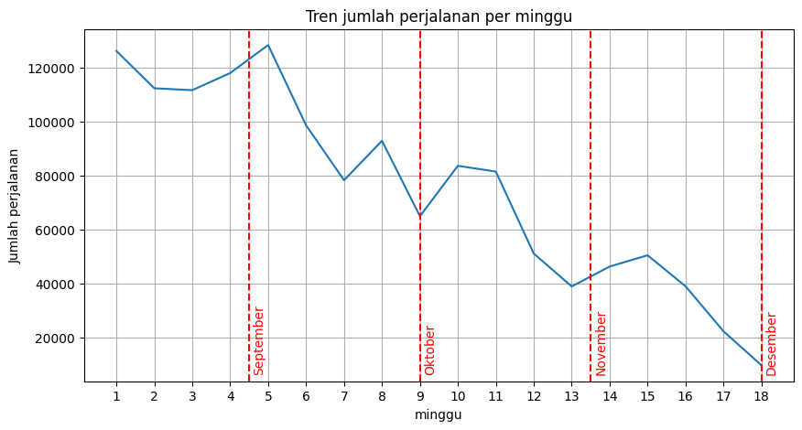
Distribution of Casual & Member Based on Week
Trend The number of trips made by all users tends to decrease.
The maximum number of trips made by all users is in the 5th week or the first week of October.
The lowest number of trips in the 18th week or the last week of December
The number of trips in September and October is greater than the number of trips in November and December.

Slide 17
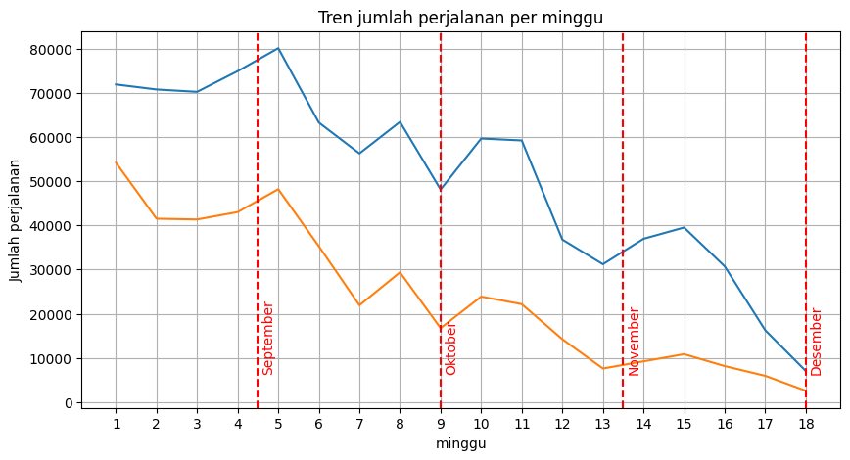
Distribution of Casual Based on Week
Trend The number of trips made by casual users tends to decrease.
The highest number of trips made by casual users was in the first week or first week of September.
The lowest number of trips in the 18th week or the last week of December
The number of trips in September and October is greater than the number of trips in November and December.

Slide 18
Distribution of Member Based on Week
It can be concluded that the number of trips in Q3 month by month tends to decrease, this is more visible in the trend in the number of Casual users.
Therefore, the analysis will focus more on the 2 months with the largest number of users (especially Casual users), namely September and October.

Slide 19

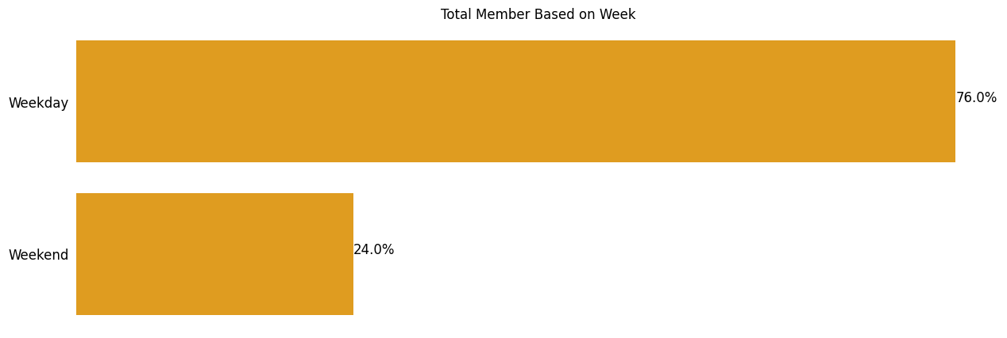
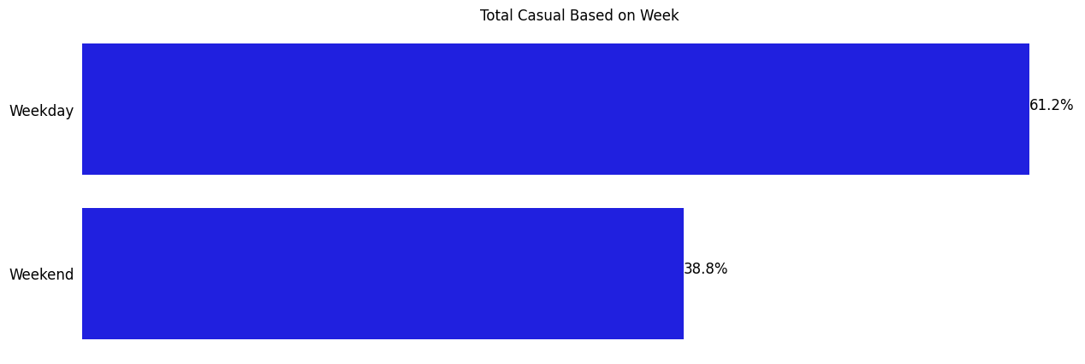
Distribution of Member Based on Day
The proportion of trips by Casual and Member users is equally large on weekdays (Monday-Friday)
The proportion of trips by Casual users on weekends is greater (38.8%) than the proportion of trips by Member users on weekends (24.0%)

Slide 20
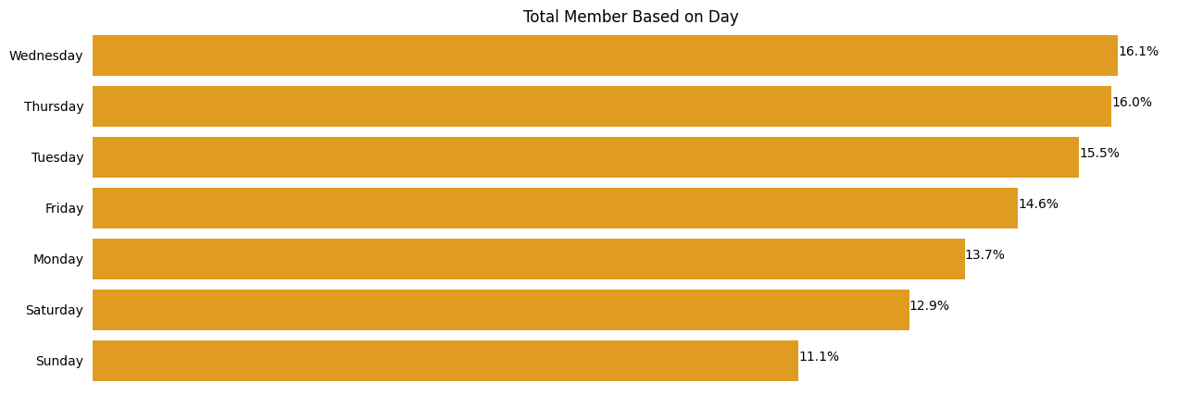
Distribution of Casual Based on Day
The highest number of trips by Member users on Wednesday
The number of trips by Member users on each weekday (Monday-Friday) is greater than on each weekend day (Saturday & Sunday)

Slide 21
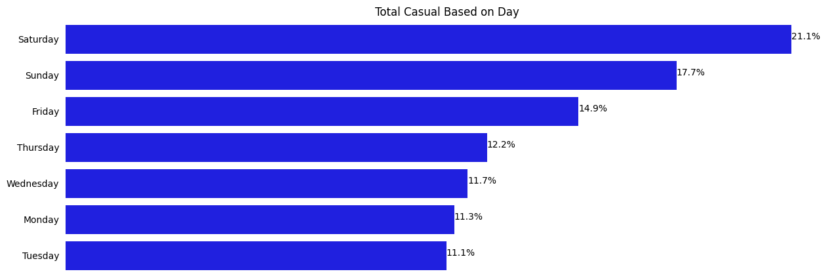
Distribution of Member Based on Day
The highest number of trips by Casual users is on Saturdays
The number of trips by Casual users on each weekend (Saturday & Sunday) is greater than on each weekday (Monday-Friday)

Slide 22
Distribution of Member Based on Day
It can be concluded that the trips made by Casual and Member Users are on weekdays (Monday-Friday).
Assuming that Casual users who travel on weekdays have greater similarities with member users than on weekends, the analysis will focus more on September and October on weekdays.
However, there are quite a lot of casual trips on weekends, so we made a side analysis that focuses on casual trips on weekends.

Slide 23
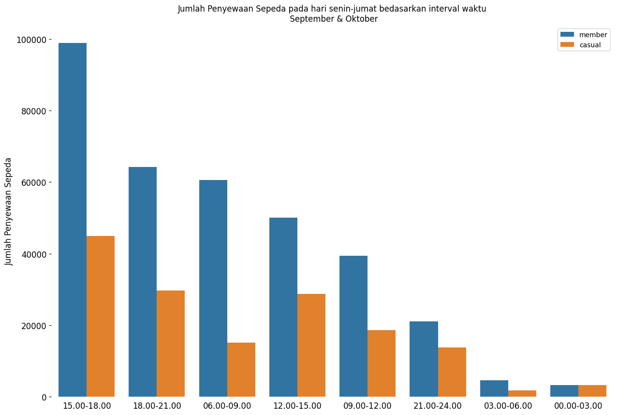

Analysis Casual & Member Based on Interval Time Sep - Oct
The highest number of bicycle rentals by member users in the interval 15.00-18.00
Top 5 hour intervals with the most rentals are:
15.00-18.00
18.00-21.00
06.00-09.00
12.00-15.00
09.00-12.00

Slide 24
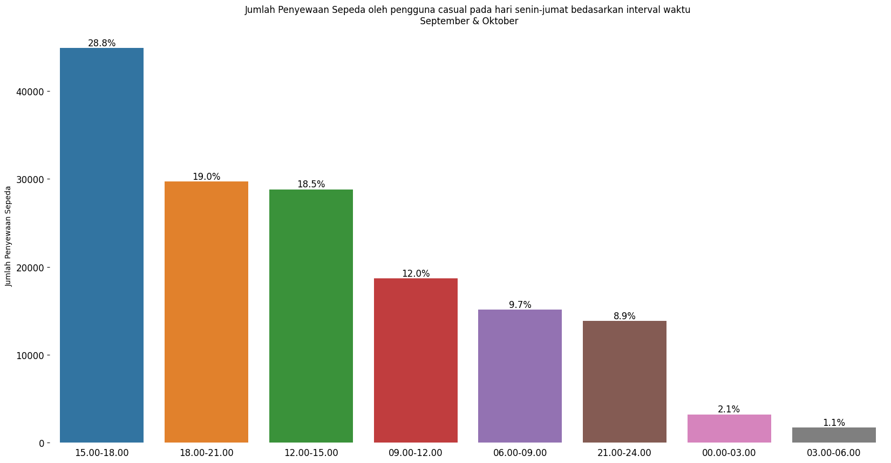
Analysis Casual Based on Interval Time Sept - Oct
The highest number of bicycle rentals by casual users in the interval 15.00-18.00
Top 5 hour intervals with the most rentals are:
15.00-18.00
18.00-21.00
12.00-15.00
09.00-12.00
06.00-09.00.
This interval hour is included in the top 5 interval hours for the number of bicycle rentals by member users

Slide 25
Analysis Casual Based on Interval Time Sept - Oct
It can be concluded that the Top 5 hour intervals for the number of bicycle rentals by casual users and members are :
15.00-18.00
18.00-21.00
12.00-15.00
09.00-12.00
06.00-09.00.
With this conclusion, the analysis will focus on the interval hours mentioned.

Slide 26
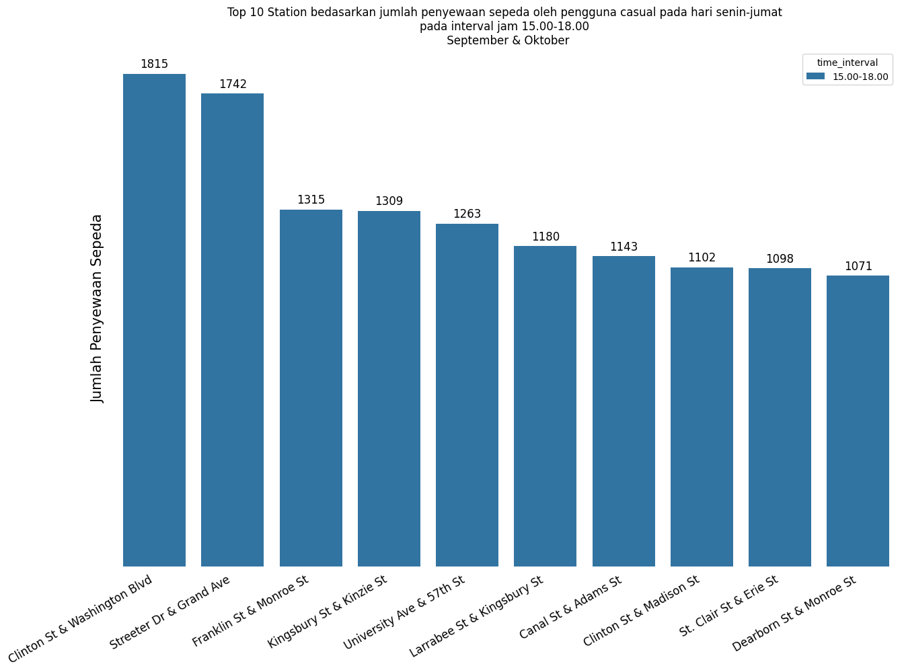
Analysis Casual Based on Interval Time Monday - Friday (15.00 - 18.00)
The station with the most rentals by casual users in the 15.00-18.00 interval is : Clinton St & Washington Blvd
Top 10 stations in the 15.00-18.00 interval have a number of rentals above 1000
Advertisement campaigns on stations at this interval will reach the most Casual users compared to other interval hours.

Slide 27
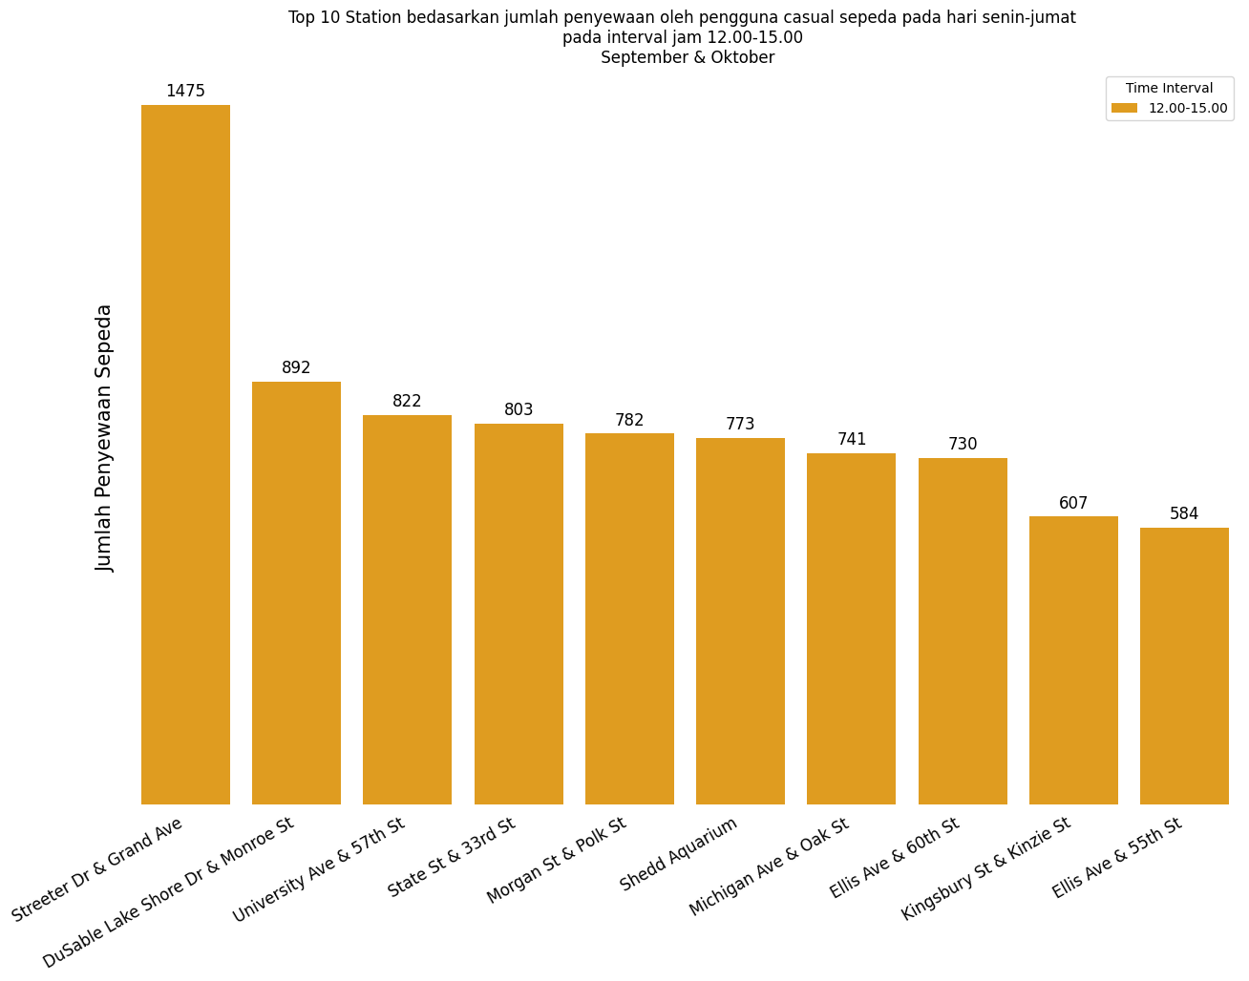
Analysis Casual Based on Interval Time Monday - Friday (12.00 - 15.00)
The station with the most rentals by casual users in the 12.00-15.00 interval is Streeter Dr & Grand Ave

Slide 28
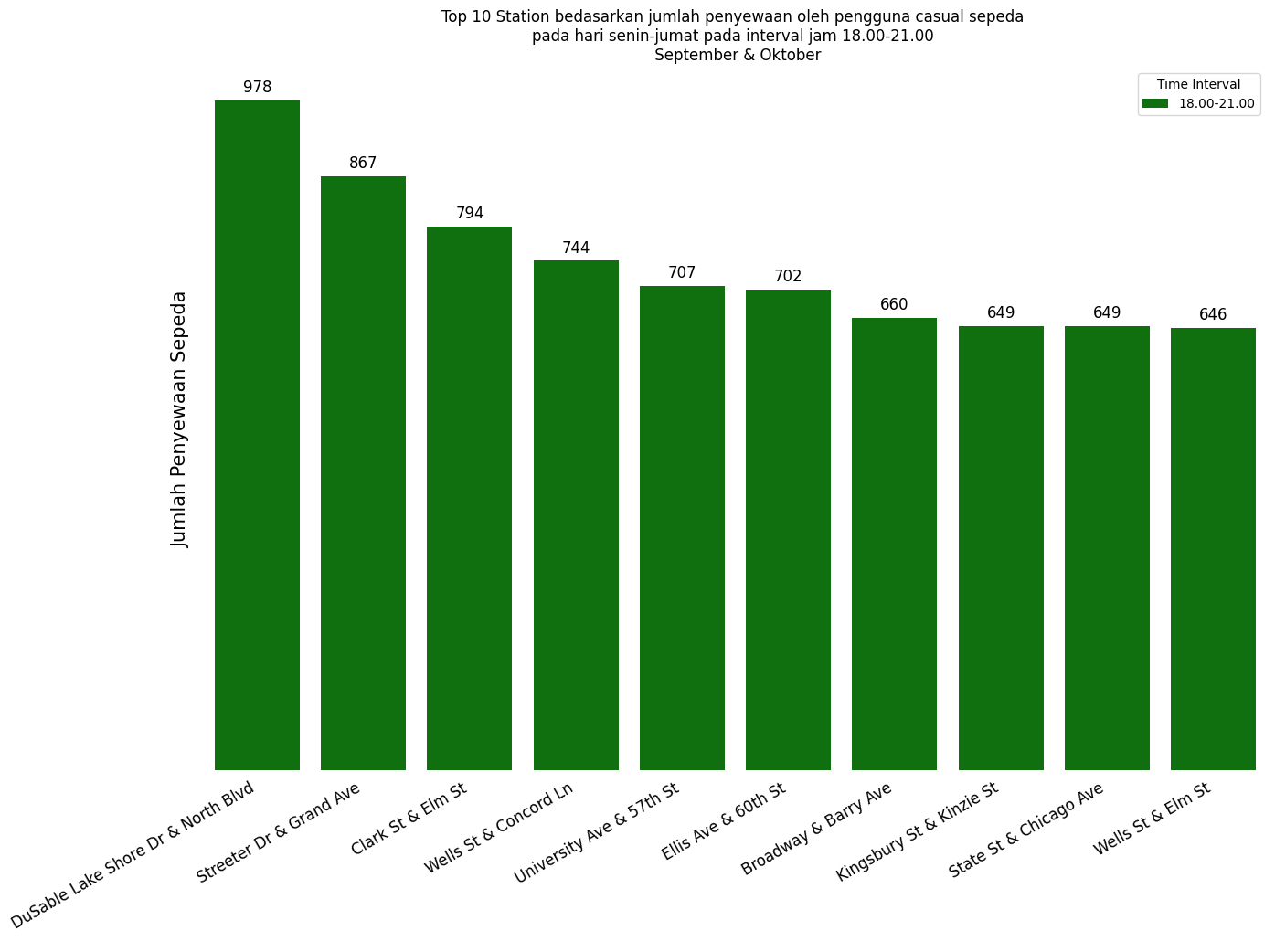
Analysis Casual Based on Interval Time Monday - Friday (18.00 - 21.00)
The station with the most rentals by casual users in the 18.00-21.00 interval is DuSable Lake Shore Dr & North Blvd

Slide 29
CONCLUSION

Slide 30
The conclusion obtained is that in Q3, users made the most rentals in September and October, especially on weekdays.
Many rentals occur in the time interval 12.00-21.00 at certain stations such as Clinton St & Wash. Blvd, Streeter Dr & Gr. Ave, Kingsbury St & Kinzie St, and so on.

Slide 31
RECOMMENDATION

Slide 32
If you want to carry out activities or programs to increase the conversion of casual users to members in Q3, it is best to do it in September and October, on Monday - Friday, at the interval 12.00 - 21.00 on stations certain.
Below is a table of the top 10 stations with the highest number of casual users at the specified time interval :
Jam Interval | 1 | 2 | 3 | 4 | 5 | 6 | 7 | 8 | 9 | 10
15.00-18.00 | Clinton St & Wash. Blvd | Streeter Dr & Gr. Ave | Franklin St & Mon. St | Kingsbury St & Kinzie St | University Ave & 57th St | Larrabee St & Kingsbury St | Calan St & Adam St | St. Clair St & Erie St. | Clinton St & Mad. St | Dearborn St & Monroe St
12.00-15.00 | Streeter Dr & Gr. Ave | DuSable L. S Dr & Monroe St | University Ave & 57th St | State St & 33rd St | Morgan St & Polk St | Shedd Aquarium | Michigan Ave & Oak St | Ellis Ave & 60th St | Kingsbury St & Kinzie St | Ellis Ave & 55th St
18.00-21.00 | DuSable L. S Dr & Monroe St | Streeter Dr & Gr. Ave | Clark St & Elm St | Wells St & Concord Ln | University Ave & 57th St | Ellis Ave & 60th St | Broadway & Barry Ave | State St & 33rd St | Kingsbury St & Kinzie St | Wells St & Elm St
If you want to do it on Saturday Sunday, then do it on the stations Streeter Dr & Grande AVe, DuSable L.S. Dr & Monroe St, Shedd Aquarium, Millennium Park, and Michigan Ave & Oak St

Slide 33


THANK YOU
OFFICE
www.divy.com

Slide 34
APPENDIX

Slide 35

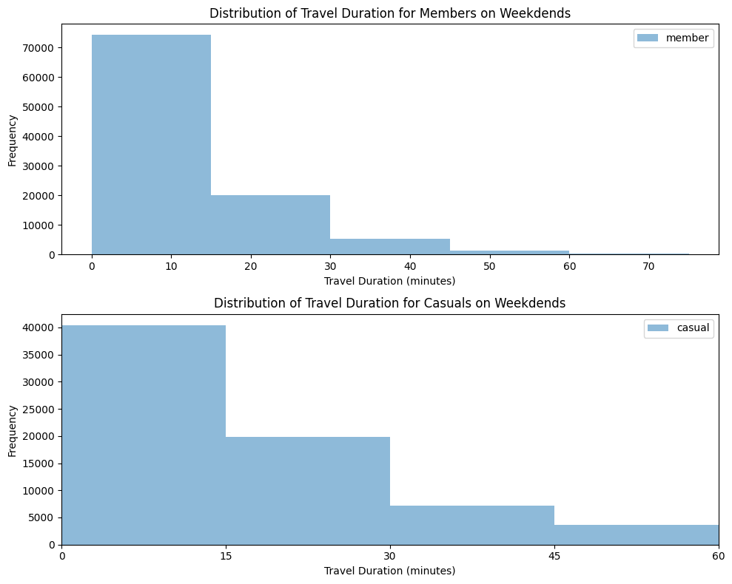
Analysis Total Duration
It was found that the proportion of bicycle rental duration by casual users was similar to the proportion of member users.
Assuming that casual users who rent under 45 minutes are most interested in becoming members compared to other casual users. So, based on the graph above, there are many casual users who have the potential to become members on weekends.

Slide 36
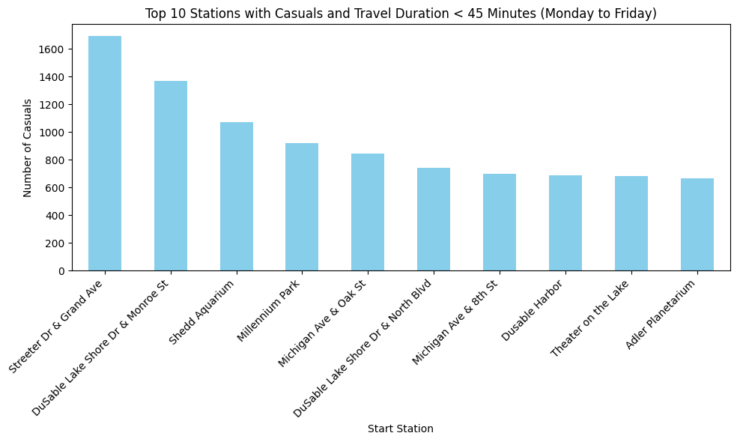
Analysis Total Duration
Street Dr & Grand Ave is the station with the highest number of rentals by casual users on weekends
Stations with the most rentals on weekends tend to be recreational areas (DuSable Lake Shore Dr & Monroe St, Shedd Aquarium, Millennium Park, etc.)
It can be concluded that quite a lot of casual users have similarities with `member` users in terms of time duration. If you want to run an Advertisement Campaign, it is recommended to do it on the stations in the graph beside.

Slide 37
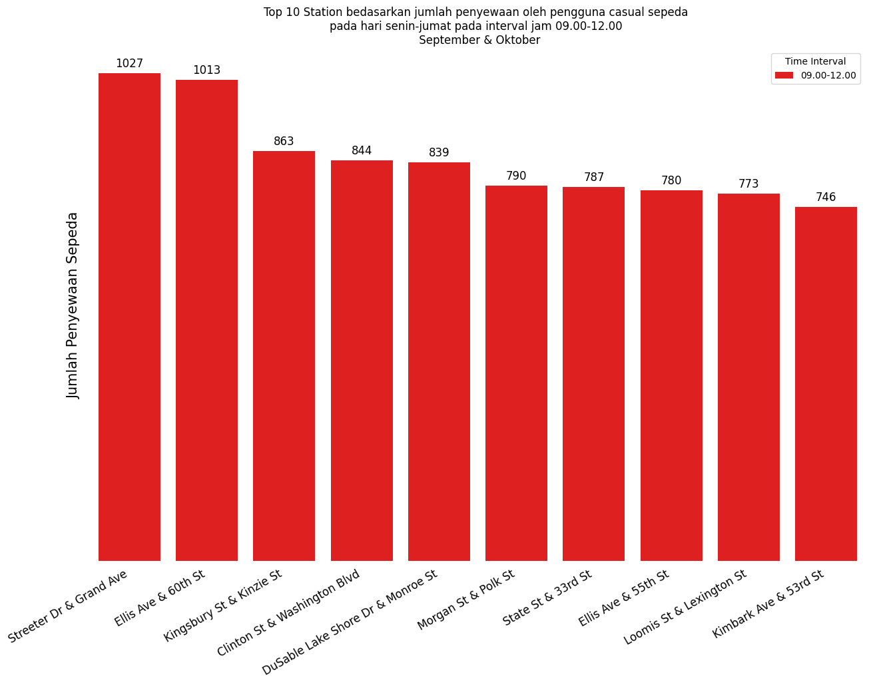
Analysis Casual Based on Interval Time Monday - Friday (09.00 - 12.00)
The station with the most rentals by casual users in the 09.00-12.00 interval is Streeter Dr & Grand Ave

Slide 38
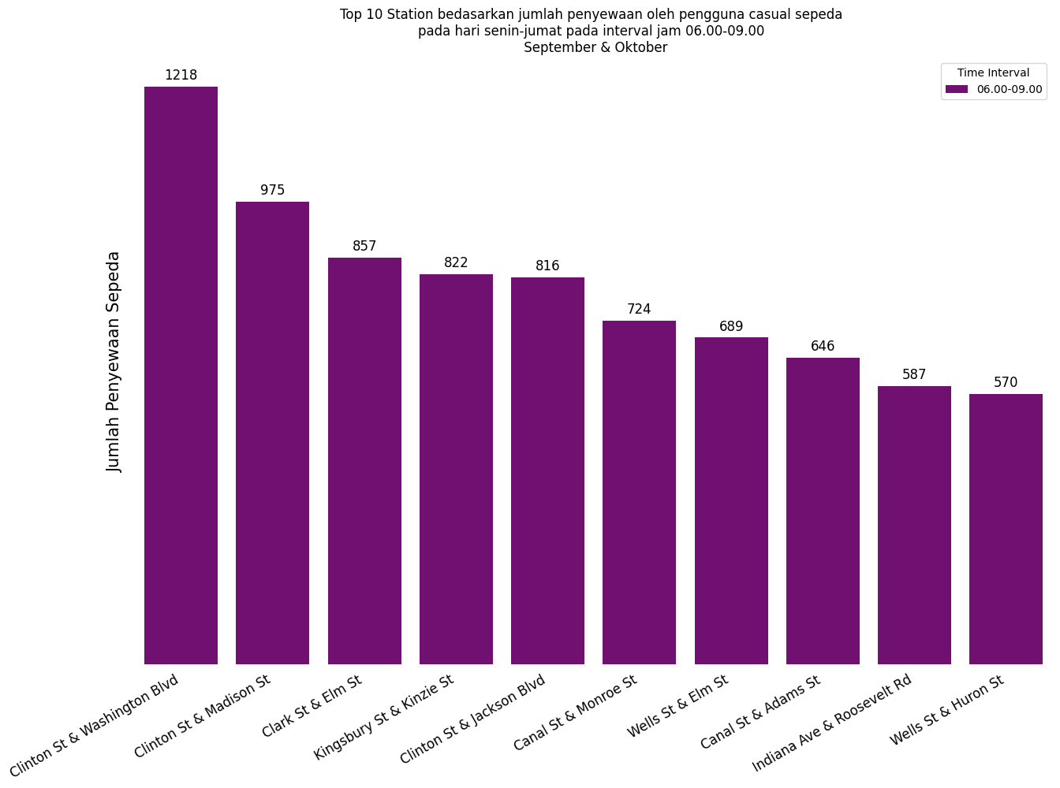
Analysis Casual Based on Interval Time Monday - Friday (06.00 - 09.00)
The station with the most rentals by casual users in the 06.00-09.00 interval is Clinton St & Washington Blvd

Slide 39
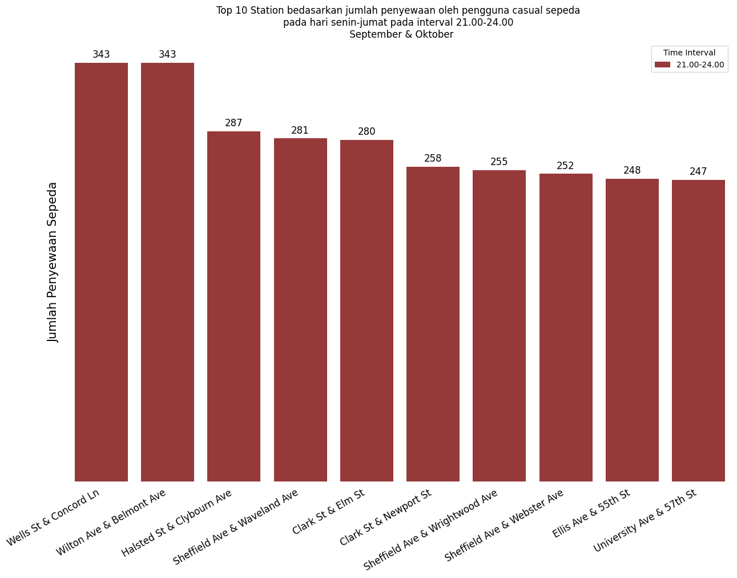
Analysis Casual Based on Interval Time Monday - Friday (21.00 - 24.00)
The station with the most rentals by casual users in the 21.00-24.00 interval is Wells St & Concord Ln
Top 10 stations in the 21.00-24.00 interval have a number of rentals below 500, so it is not recommended to carry out an advertisement campaign during this interval.

